Slide 1
Design Principles
MORS CSAP
Tuesday, March 11, 2025
Walt DeGrange

Slide 2
Agenda
Design Principles
Instruction
Guided practice
Design Critique
Instruction
Guided practice / check for understanding
Focus session: Stoplight charts

Slide 3
Design elements
Color | Shape | Position | Size
Transparency | Line Type | Composition | Text Text Text Text

Slide 4


Working with color
High contrast or saturation draws attention to most important data
Color encodes meaning and can tie visuals together
Use semantic color association
Don’t disregard grey as a method of de-emphasis

Slide 5
Color palettes
Sequential
Continuous data
Color distinction not important
Diverging
Quantitative data display
Progresses outward from a critical midpoint in data range
Qualitative
Nominal data
Color distinction is important

Slide 6



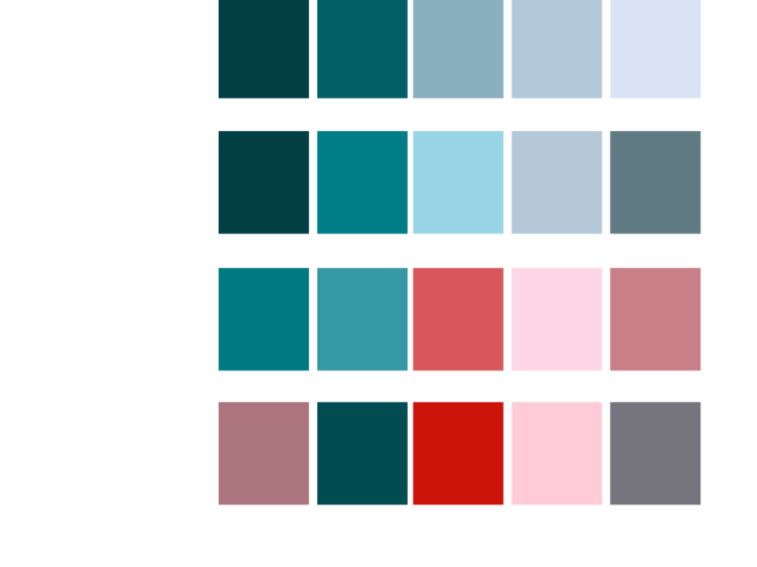
Designing for inclusivity
Normal Color Vision
Protanopia
Deuteranopia
Tritanopia
https://www.color-blindness.com/coblis-color-blindness-simulator/

Slide 7
The principle of proportional ink
“The representation of numbers, as physically measured on
the surface of the graphic itself, should be directly proportional to the numerical quantities represented.”
-Edward Tufte

Slide 8
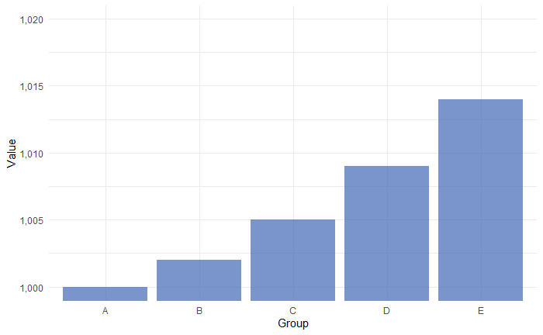
The principle of proportional ink
Why is this graph misleading?

Slide 9
Contrast
Avoid! | Great! | Acceptable
Avoid! | Alright! | Poor choice
Poor choice | Fair choice | Avoid!
Acceptable | Acceptable | Avoid!
Fair choice | Poor choice | Poor choice
Alright! | Avoid! | Acceptable
Great! | Avoid! | Fair choice
Go for high contrast (especially with small text)
Test it out
Applies to text and other graphic elements

Slide 10
Decoding encodings
Elements that provide graphical representation of data
Include color, size, position, etc.
Cleveland and McGill (1984): tested user perception of 10 elementary graphical encodings

Slide 11
Decoding encodings
How much larger is circle b than a?
Circle A
Circle B

Slide 12
Decoding encodings
How much larger is bar b than bar a?
Bar A
Bar B

Slide 13
Decoding encodings
How much larger is circle b than a?
Answer: 9x
3
1
Circle A
Circle B

Slide 14
Decoding encodings
How much larger is bar b than bar a?
Answer: 9x
Bar A
Bar B

Slide 15
Decoding encodings
This is why simple bar and scatter plots are so effective!
While elements like color and area add interest and relative information to graphics, they should be used with care.
Which encodings do viewers interpret accurately?

Slide 16

Decoding encodings
Which encodings do viewers interpret accurately?
Volume,
density,
color
saturation
Angle and
slope
Position
Generic / Relative Estimates
Accurate Estimates
Color hue
Area
Length
Findings from: Cleveland and McGill (1984)

Slide 17
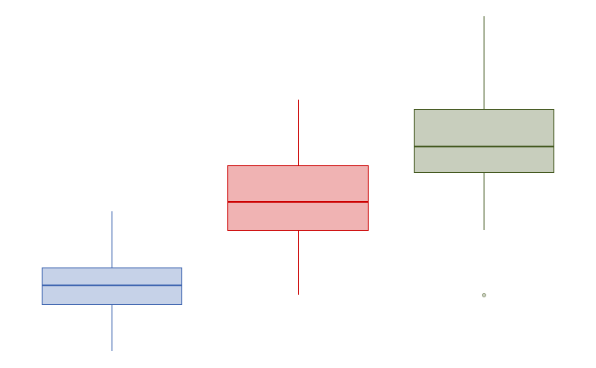

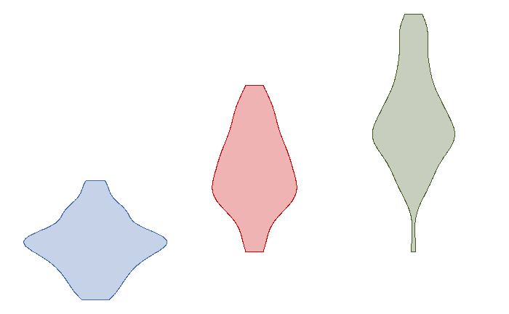
Visualizing the whole
Providing decision-makers with the right amount of information. Some prefer brief overviews, while others prefer overviews with the underlying data.
All these graphics show the same data– what do we learn from each?

Slide 18
Text in Graphics
Caption
Concise description of the data shown, highlighting data/features of note
Sub caption
Provide additional background information to help the user
Axis labels
Always label in units that are easy to understand
Legends
Aligned with the order colors and shapes appear in the graphic
Clear, concise descriptions of what is shown
Data labels
An alternate to legends

Slide 19
Embedding Information in Text
Text is another tool to embed information into graphics
Integrate text into the graphic with color, position, and style
Let’s look at some examples of this in practice

Slide 20
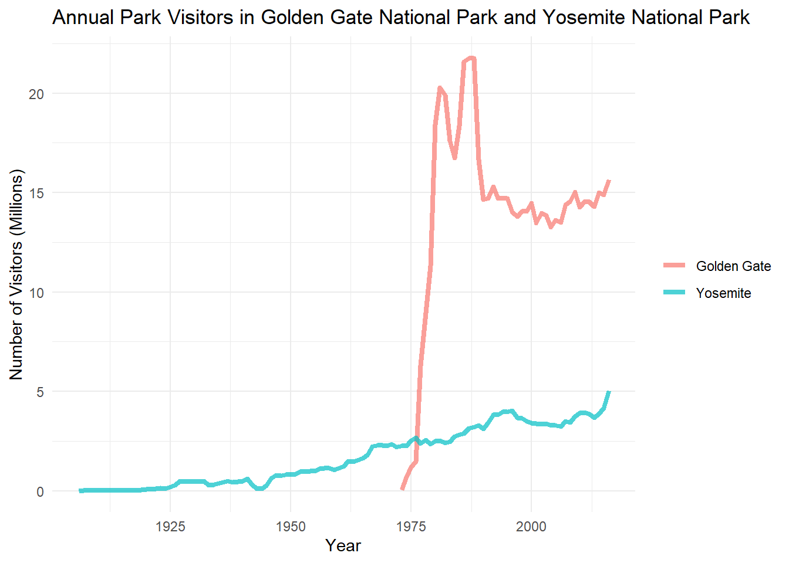
Embedding Information in Text
Option 1: Legend

Slide 21
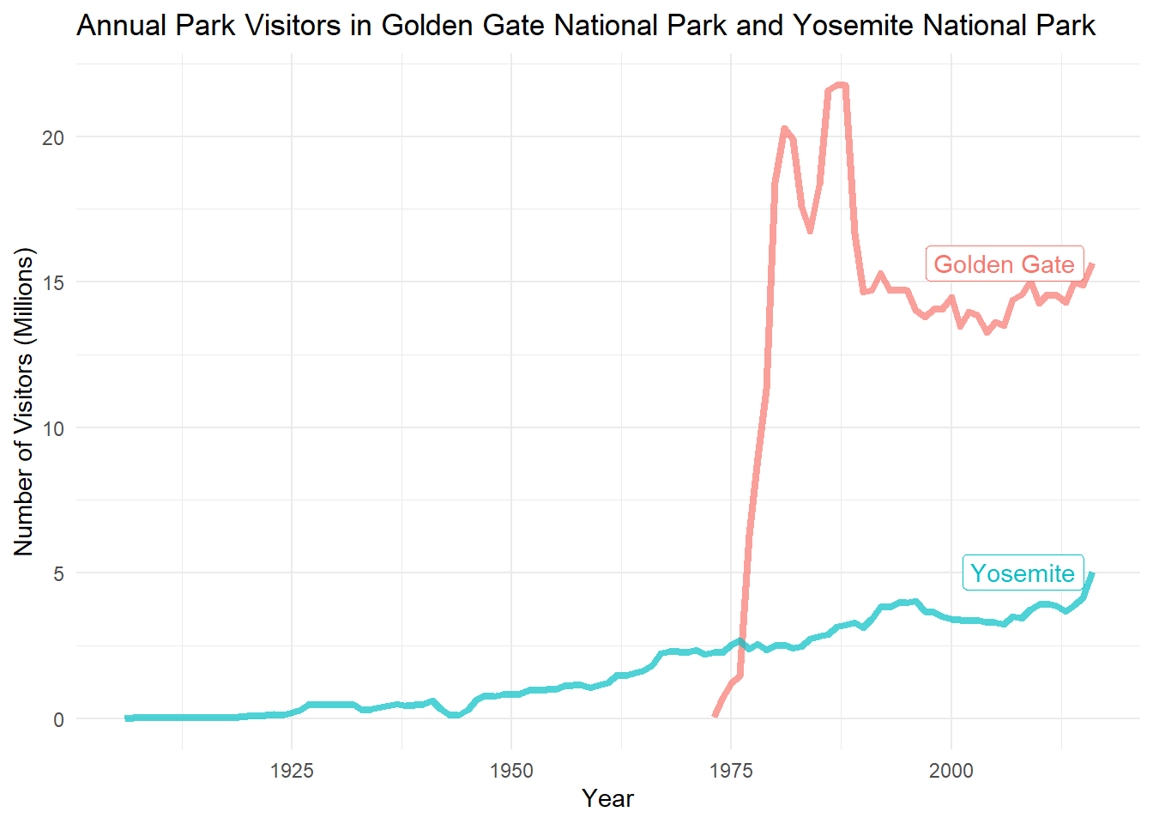
Embedding Information in Text
Option 2: Label

Slide 22
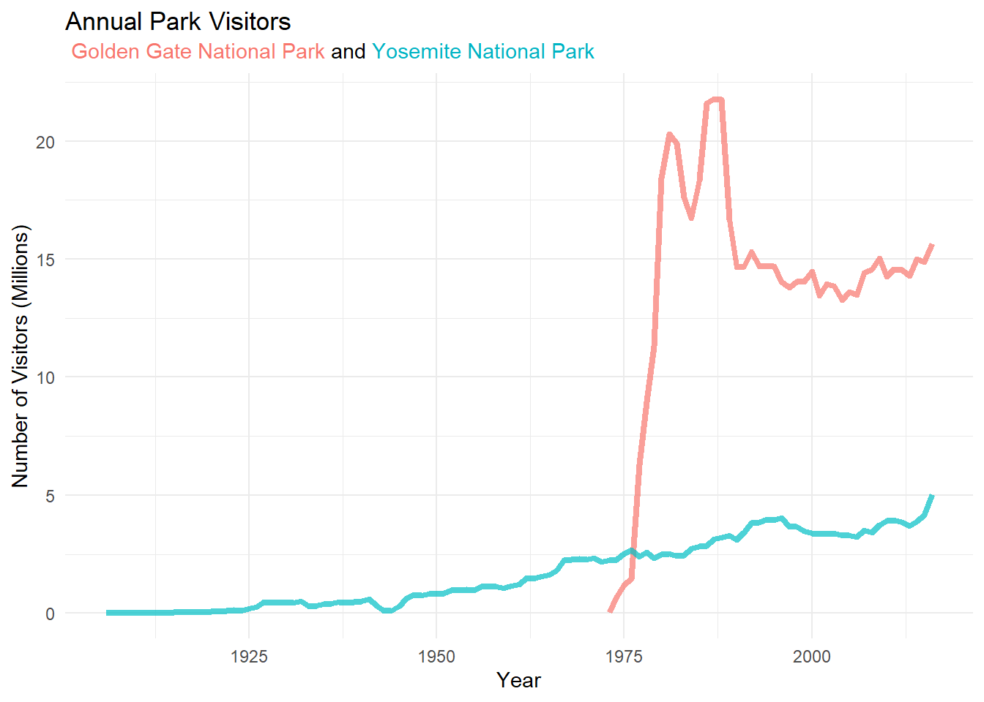
Embedding Information in Text
Option 3: Title

Slide 23
Annotations in Text
Explaining the obvious
Golden Gate National Park Opened in 1972

Slide 24

Case Study National Parks
National park visitors by year
Data fields:
Year
National park name
Region
State
Visitors

Slide 25
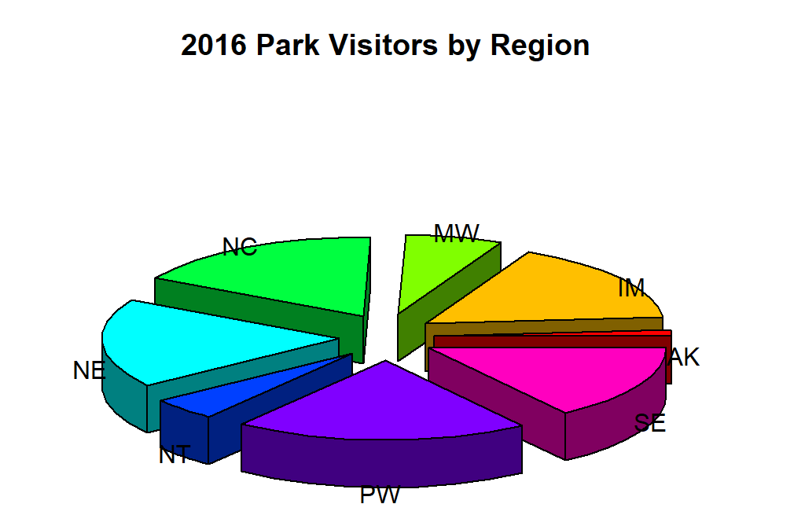
Design Critique
What challenges does this graphic pose?
How would you improve this graphic?

Slide 26
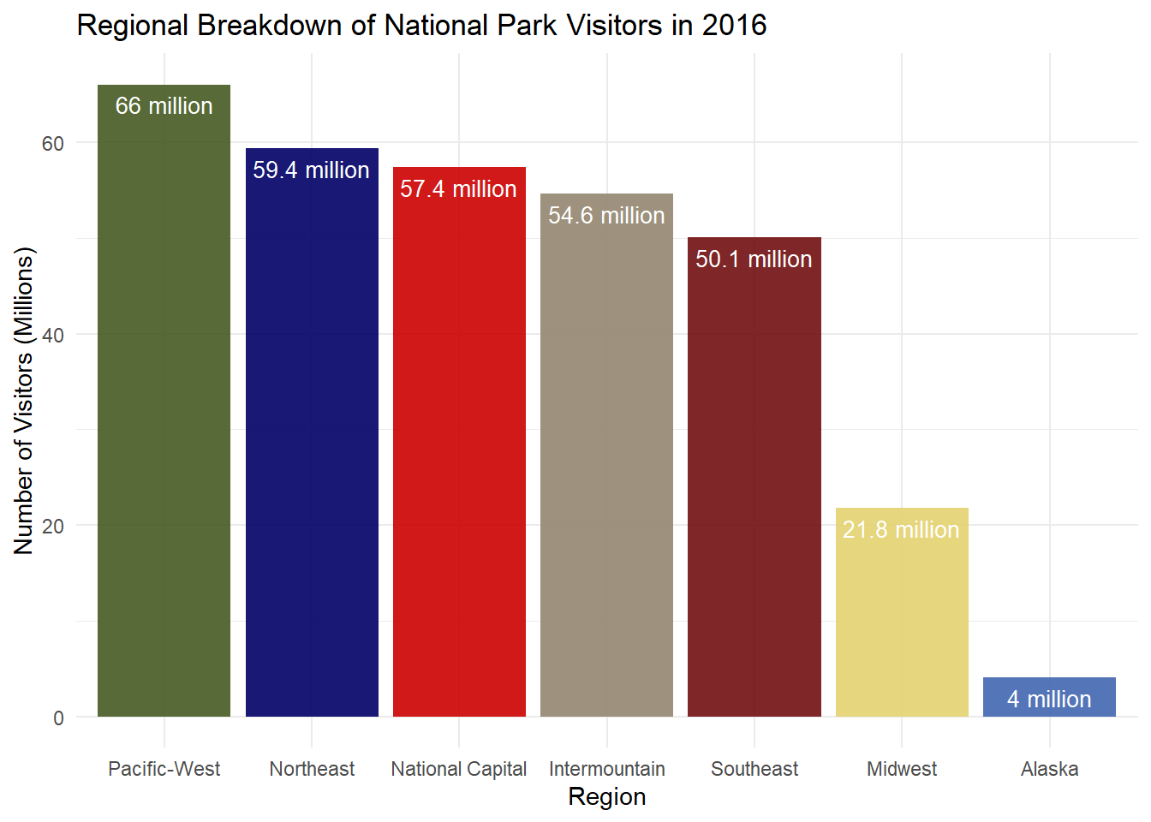
Design Critique
Original Graphic
Alternate Representation

Slide 27
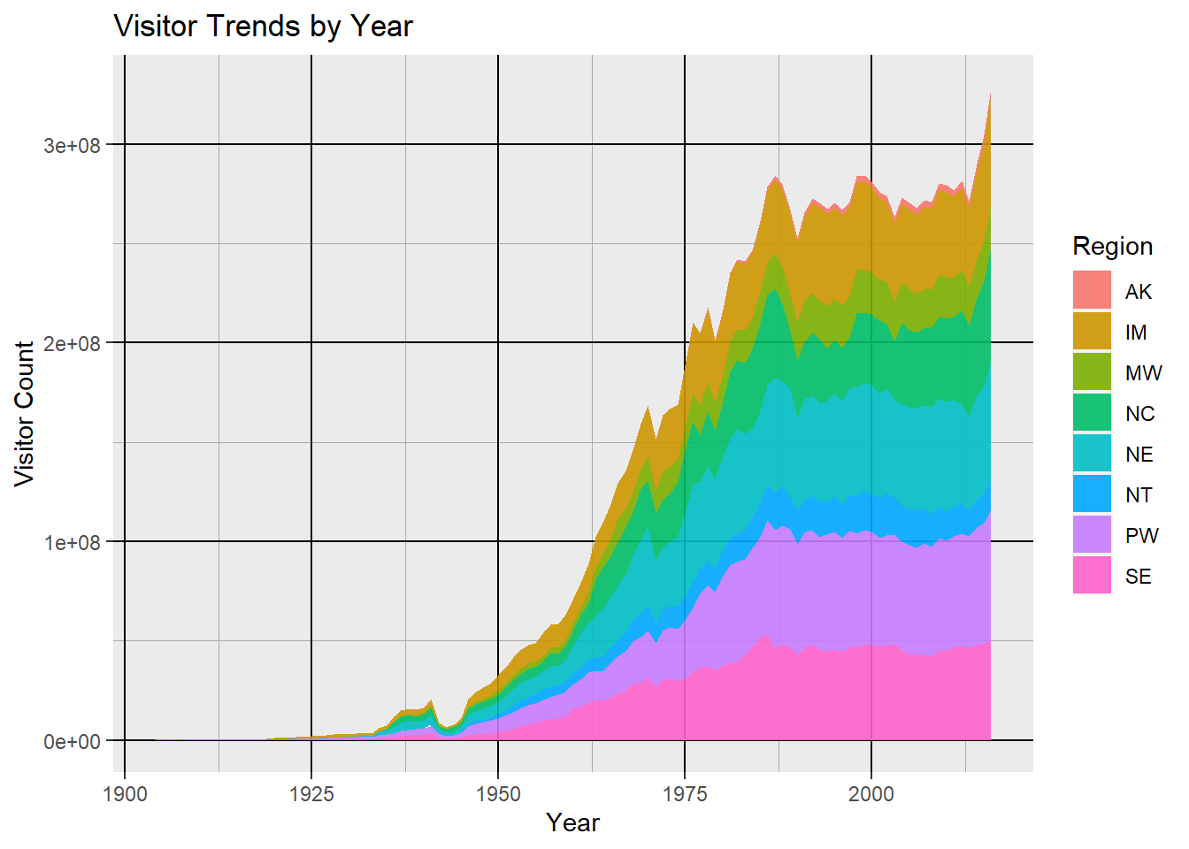
Design Critique
What challenges does this graphic pose?
How would you improve this graphic?

Slide 28
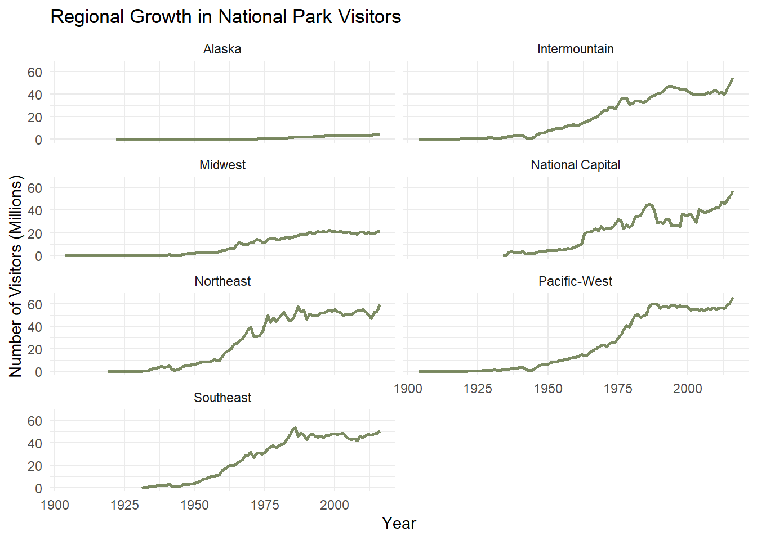
Design Critique
Original Graphic
Alternate Representation

Slide 29
Why Use Them
One stop shop
Take action quickly
Focus on issues requiring attention
Visual in nature
“the more that you can rely on images to tell the story, the faster that story can be perceived”
Stephen Few
https://www.perceptualedge.com/articles/Whitepapers/Dashboard_Design.pdf

Slide 30
Challenges with Traffic Light Reporting
6%
2%
3%
3%
Can be overwhelming
Many times rear view focused, not actionable
Many times does not measure performance
Not enough context
10% males, 1% females green/red color blind
Introduces Judgement and defensiveness
https://www.perceptualedge.com/articles/Whitepapers/Dashboard_Design.pdf

Slide 31
Sparklines and Bullet Charts
Only shown if needs attention
Sparklines provides historical Context
Target Value
Dark grey (lower scores)
Lighter grey (better scores)
Actual Value
While this can be achieved in Excel, Power BI provides a built-in solution

